Slide 1

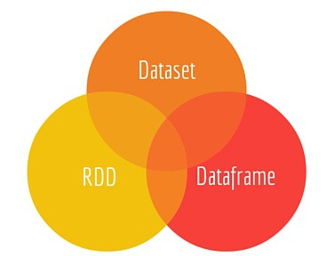

Slide 2
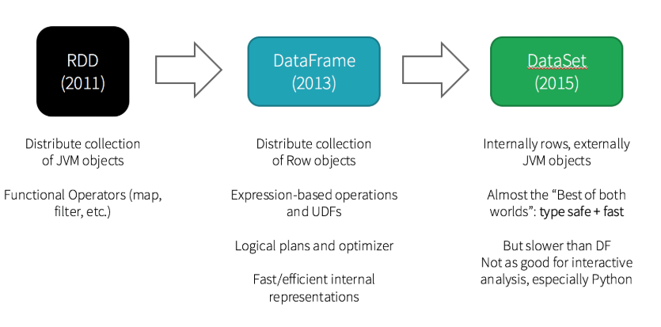

Slide 3
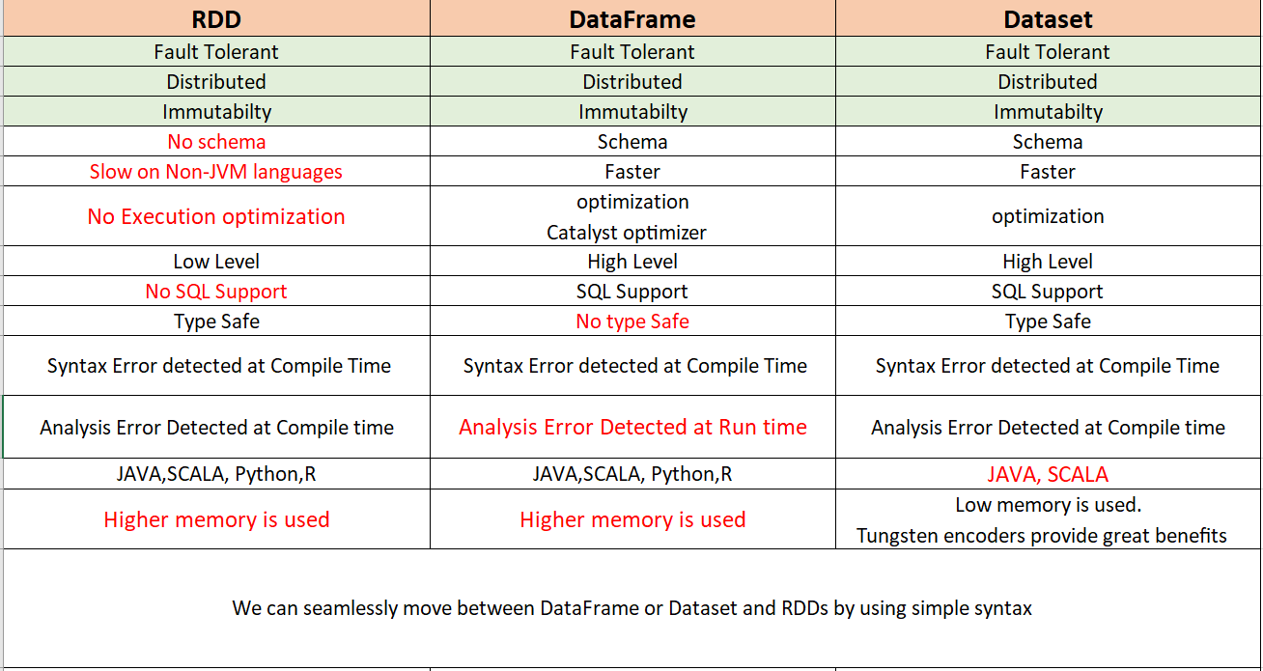
SPARK Interface API

Slide 4
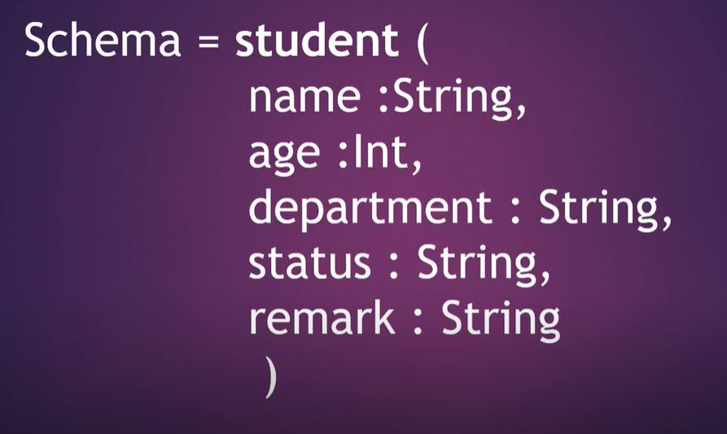


Slide 5
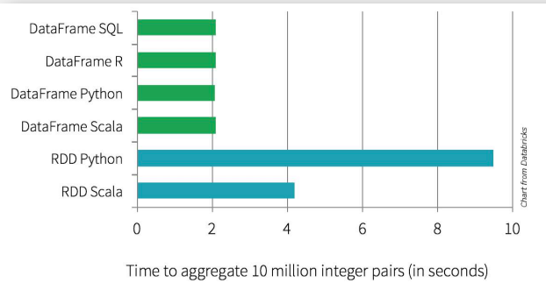

Slide 6
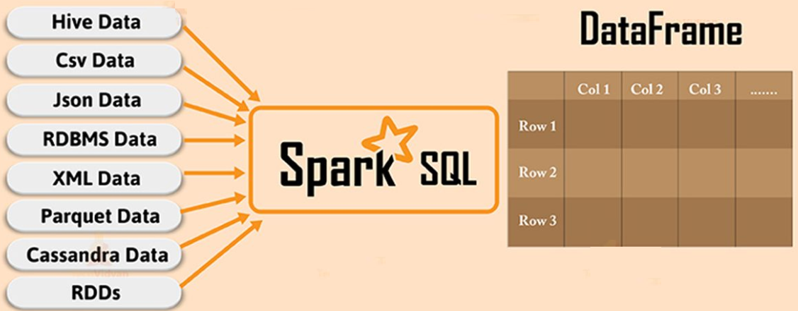
Ways to Create A DATAFRAME

Slide 7
Type Safe
Data Set = DataFrame + RDD

Slide 8
